Slide 1

Should Marketing Professionals
Learn Data Analytics?
A Machine Learning Analysis of Education, Technical Skills and Career Success
Author: Teresa Baena Mendes Coelho
Ironhack Bootcamp Data Analytics • June 2026
IRON HACK
1

Slide 2
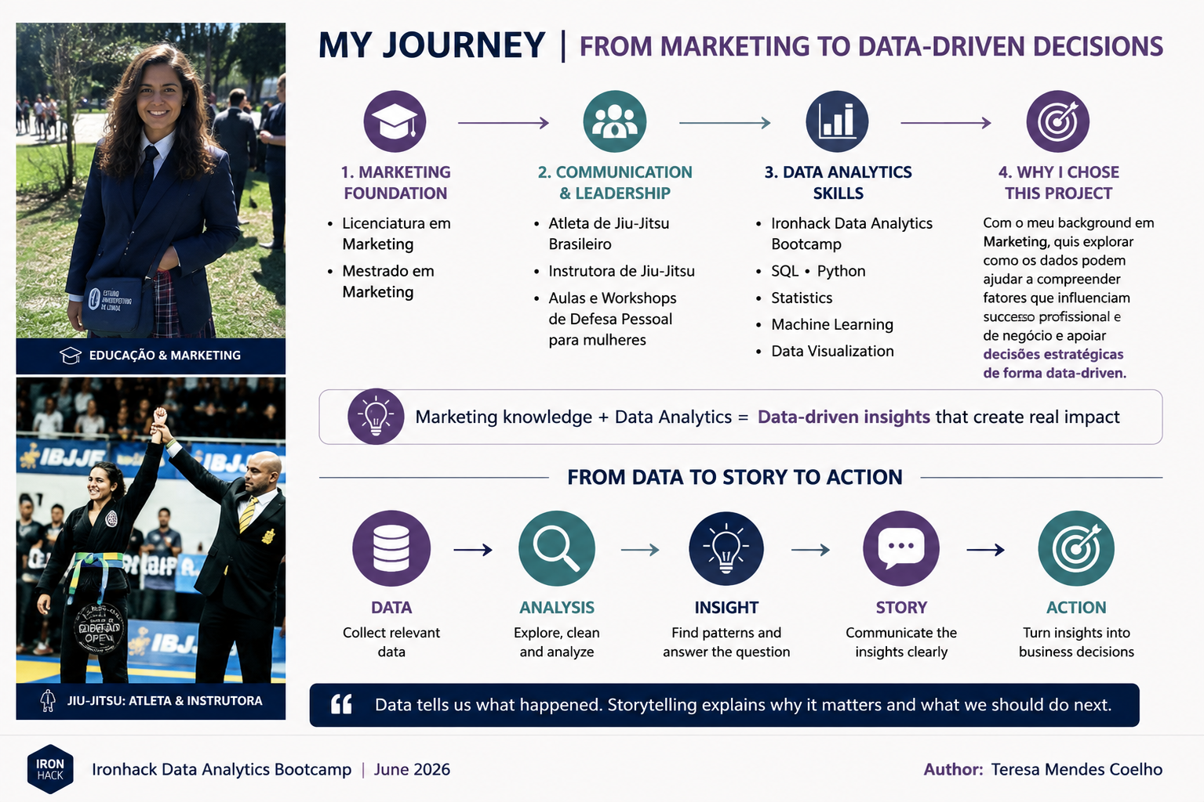


Author: Teresa Baena Mendes Coelho
Ironhack Bootcamp Data Analytics • June 2026
IRON HACK
2

Slide 3
The Business Question
From a career question to a data-driven analysis
BUSINESS PROBLEM
• Marketing roles are increasingly data-driven.
• Professionals are expected to combine marketing knowledge with analytical and technical capabilities.
• We investigate whether education, professional experience and measurable skills are associated with career outcomes.
Research Question
Can professional characteristics help explain and predict Starting Salary?
Author: Teresa Baena Mendes Coelho
Ironhack Bootcamp Data Analytics • June 2026
IRON HACK
2

Slide 4
Data & Analytical Workflow
44
observations in modelling
1
main target: Starting Salary
6
regression models
2
statistics + ML
• Business understanding → data preparation → EDA → statistical analysis → feature engineering → Machine Learning → evaluation → business interpretation
• Key variables include Starting Salary, Current Job Level, Years to Promotion, Internships Completed and other career-related indicators.
Author: Teresa Baena Mendes Coelho
Ironhack Bootcamp Data Analytics • June 2026
IRON HACK
3

Slide 5
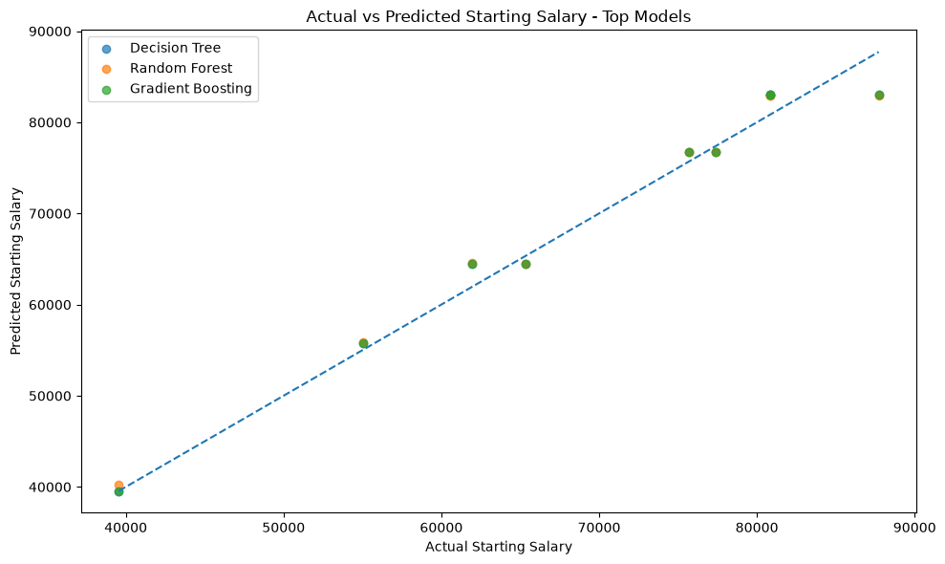
Exploratory Analysis: Career Level & Salary
Tableau visualization
Author: Teresa Baena Mendes Coelho
Ironhack Bootcamp Data Analytics • June 2026
IRON HACK
4

Slide 6
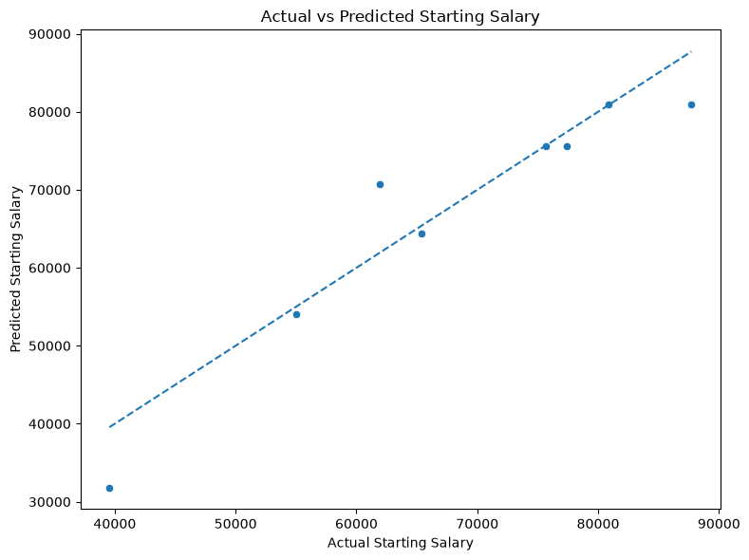
Exploratory Analysis: Salary Distribution
Python visualization
• Starting Salary spans a broad range in the sample.
• The distribution is concentrated toward the higher end of the observed range.
• This motivates combining descriptive analysis with predictive modelling.
Author: Teresa Baena Mendes Coelho
Ironhack Bootcamp Data Analytics • June 2026
IRON HACK
5

Slide 7
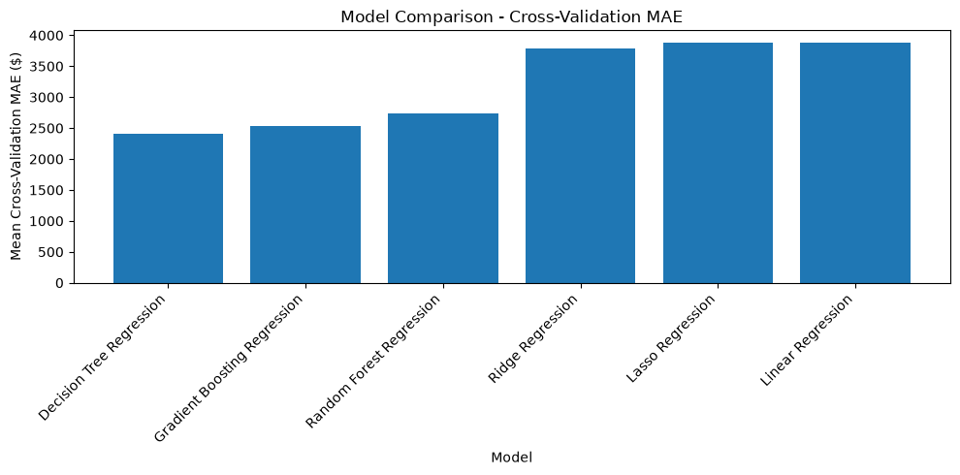
Career Progression & Starting Salary
Tableau dashboard
Author: Teresa Baena Mendes Coelho
Ironhack Bootcamp Data Analytics • June 2026
IRON HACK
6

Slide 8
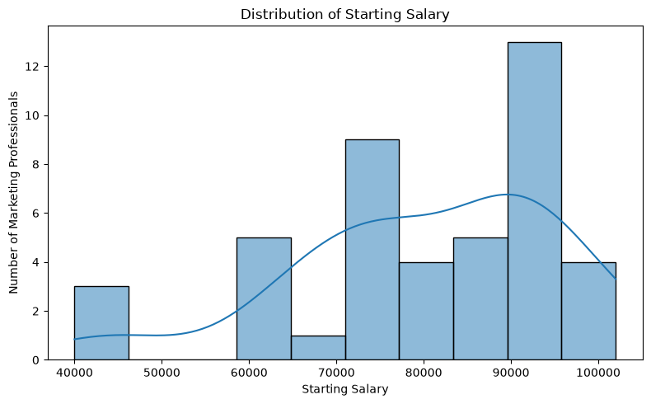
Statistical Analysis: OLS Regression
Testing relationships before moving to prediction
0.899
OLS R²
0.889
Adjusted R²
• The OLS model explains a large share of observed salary variation.
• Several included predictors are statistically significant in this sample.
• Statistical significance and predictive performance answer different questions.
Author: Teresa Baena Mendes Coelho
Ironhack Bootcamp Data Analytics • June 2026
IRON HACK
7

Slide 9
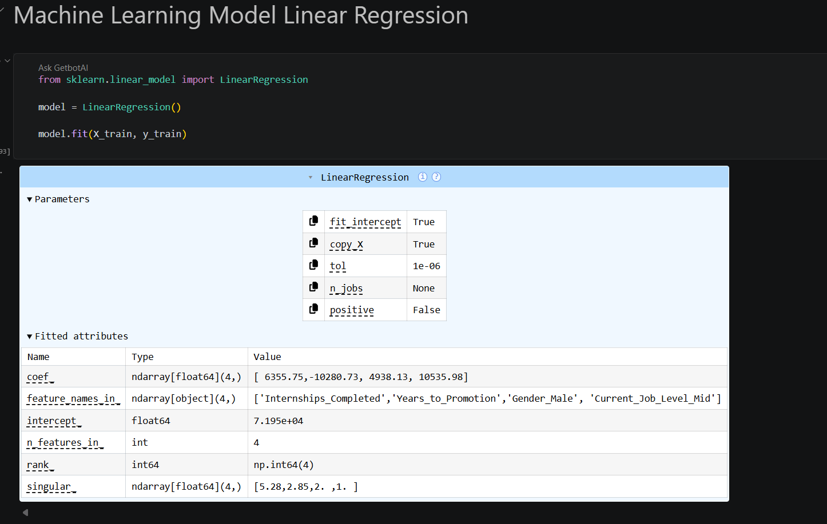
Linear Regression: Interpreting Associations
• Internships Completed: positive coefficient
• Years to Promotion: negative coefficient
• Gender_Male: positive coefficient in the fitted model
• Current Job Level Mid: positive coefficient
• Important: coefficients describe model associations, not causal effects.
Author: Teresa Baena Mendes Coelho
Ironhack Bootcamp Data Analytics • June 2026
IRON HACK
8

Slide 10
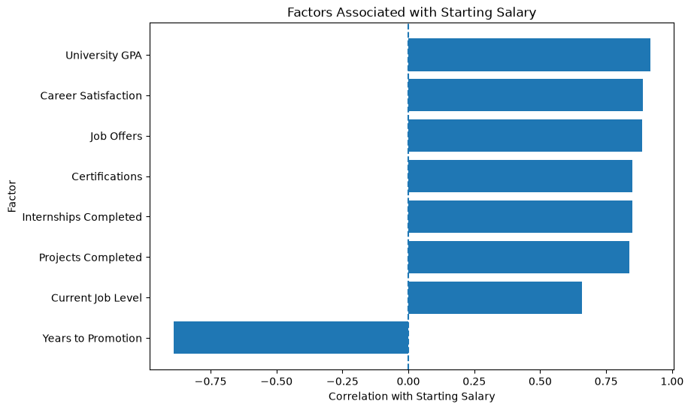
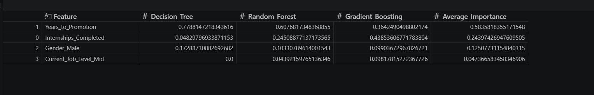
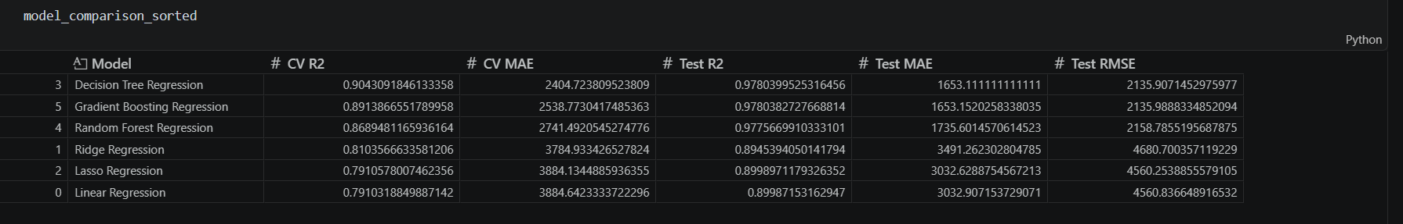
Machine Learning: Model Comparison
Cross-validation and test-set performance
Author: Teresa Baena Mendes Coelho
Ironhack Bootcamp Data Analytics • June 2026
IRON HACK
9

Slide 11
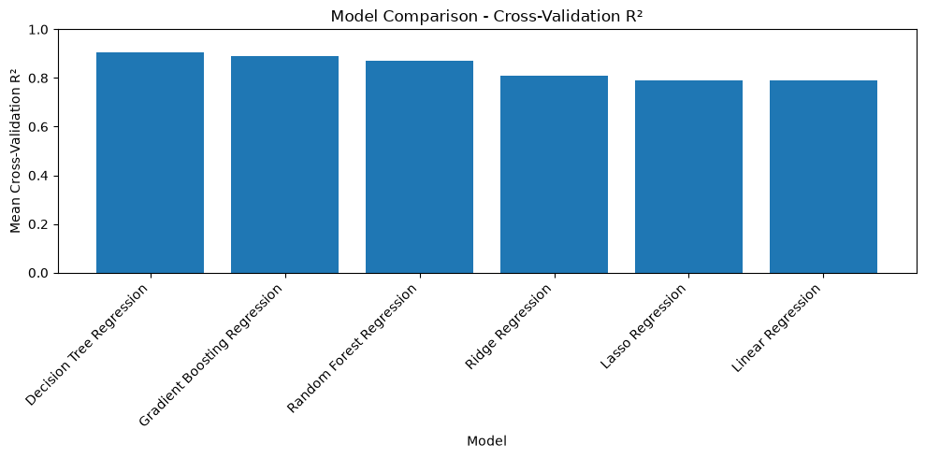
Best Performing Models
Decision Tree leads on cross-validation
0.904
Decision Tree CV R²
€1,653
Decision Tree Test MAE
€2,136
Decision Tree Test RMSE
• Gradient Boosting was extremely close on the test set.
• Random Forest also showed strong predictive performance.
Author: Teresa Baena Mendes Coelho
Ironhack Bootcamp Data Analytics • June 2026
IRON HACK
10

Slide 12
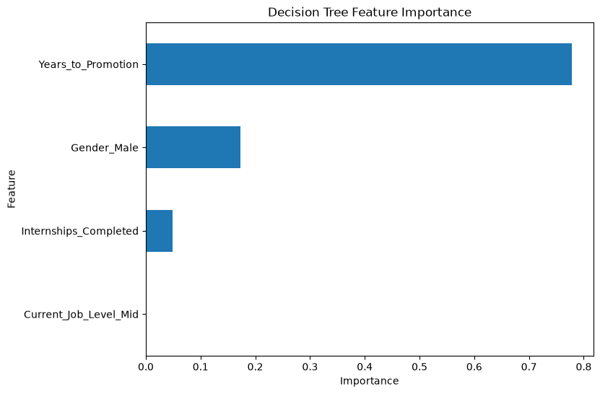
Decision Tree: Actual vs Predicted Salary
Model validation on the test set
• Predictions are close to the 45° reference line.
• Test R² is approximately 0.978.
• The model captures the salary patterns in the held-out test sample well.
Author: Teresa Baena Mendes Coelho
Ironhack Bootcamp Data Analytics • June 2026
IRON HACK
11

Slide 13
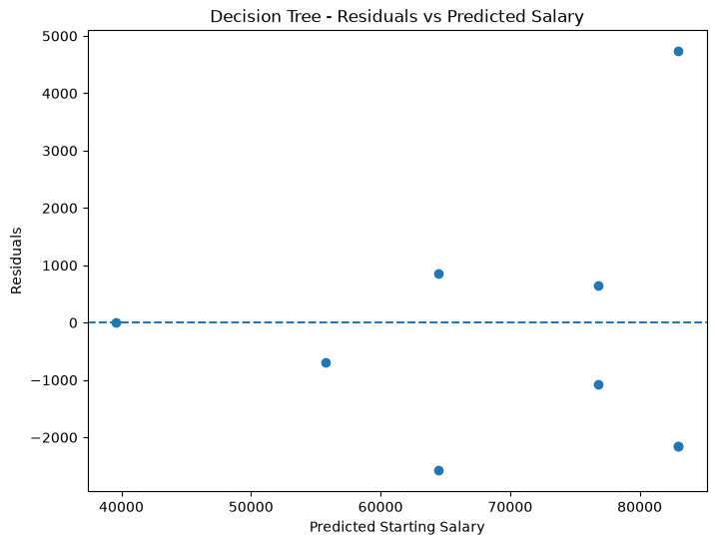
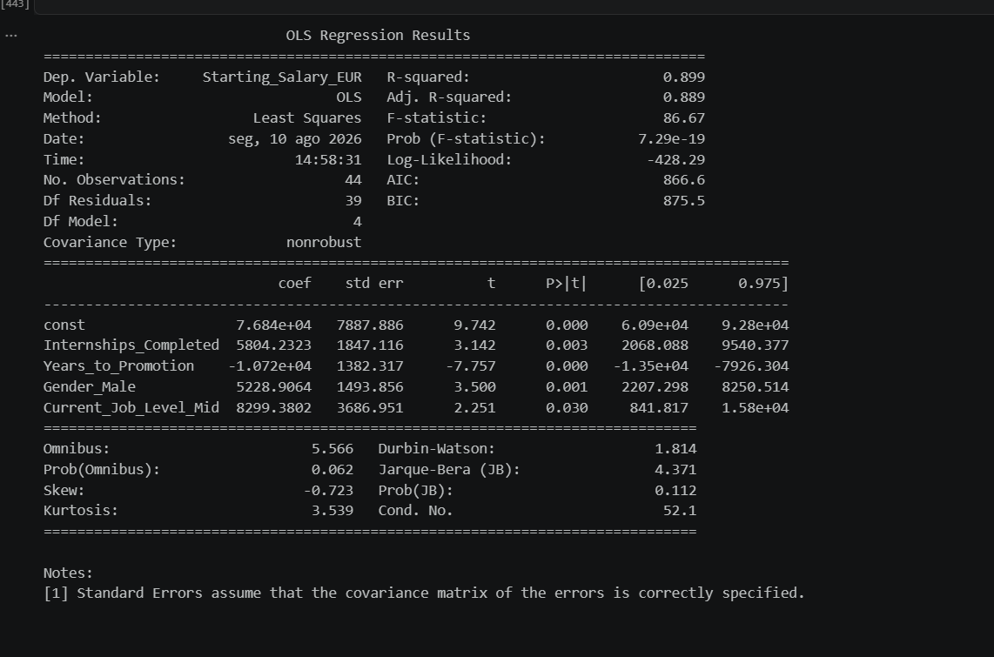
What Drives the Prediction?
Feature importance across tree-based models
• Years to Promotion is the strongest feature in the Decision Tree.
• Average importance across three tree-based models also ranks Years to Promotion first.
• Internships Completed is the second-largest average importance.
Author: Teresa Baena Mendes Coelho
Ironhack Bootcamp Data Analytics • June 2026
IRON HACK
12

Slide 14
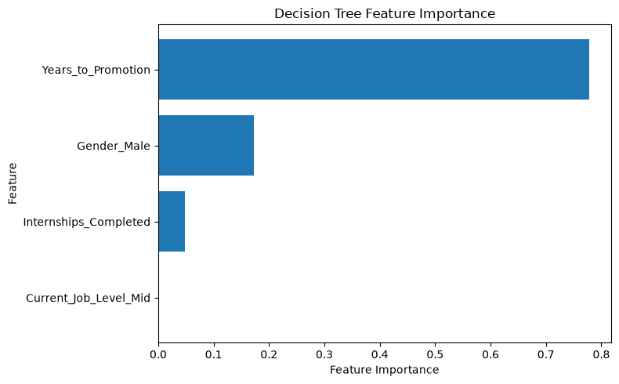
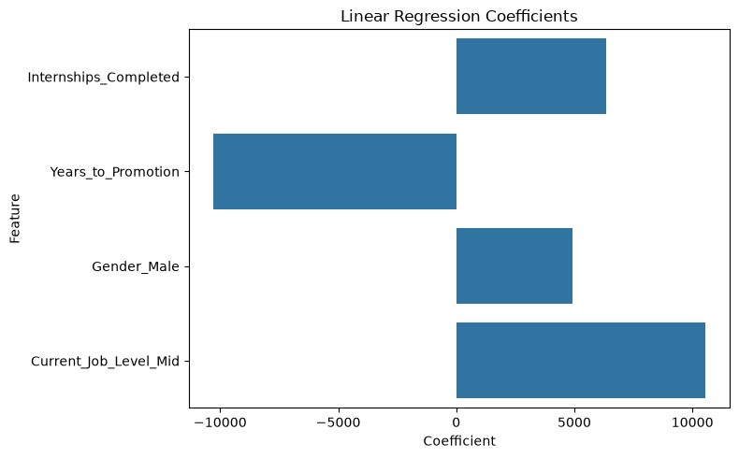
Model Diagnostics
Residuals and actual-vs-predicted checks
Author: Teresa Baena Mendes Coelho
Ironhack Bootcamp Data Analytics • June 2026
IRON HACK
13

Slide 15
Key Findings
What the combined Tableau + Python analysis tells us
01
Career level is strongly associated with starting salary.
02
Years to Promotion is the strongest predictive feature in the tree-based models.
03
Internships Completed contributes meaningfully to the predictive models.
04
Decision Tree Regression achieved the strongest cross-validation performance.
05
The results support relationships between career characteristics and salary — not a causal claim.
Author: Teresa Baena Mendes Coelho
Ironhack Bootcamp Data Analytics • June 2026
IRON HACK
14

Slide 16
So… Should Marketing Professionals Learn Data Analytics?
The business conclusion
YES — with a data-driven perspective.
• Data literacy and technical skills can strengthen a marketing professional’s ability to understand business performance and make evidence-based decisions.
• Career development and practical experience are strongly associated with salary outcomes in this dataset.
• This project does not prove that learning Data Analytics directly causes higher salaries.
Author: Teresa Baena Mendes Coelho
Ironhack Bootcamp Data Analytics • June 2026
IRON HACK
15

Slide 17
From Marketing to Data Analytics
A personal motivation behind the project
Marketing
Business & customer knowledge
Data Analytics
SQL • Python • Tableau
Machine Learning
Prediction & pattern recognition
Career Opportunities
Data-driven decision making
→
→
→
The goal is not to replace marketing expertise with data — but to combine both.
Author: Teresa Baena Mendes Coelho
Ironhack Bootcamp Data Analytics • June 2026
IRON HACK
16

Slide 18
Final Takeaway
0.904
Best CV R²
0.978
Best Test R²
€1,653
Best Test MAE
1st
Years to Promotion
• Use Tableau to communicate the business patterns.
• Use statistics to understand relationships.
• Use Machine Learning to evaluate predictive performance.
• Turn the results into practical, evidence-based recommendations.
Thank you • Questions?
Author: Teresa Baena Mendes Coelho
Ironhack Bootcamp Data Analytics • June 2026
IRON HACK
17

Slide 19
SQL Validation & Exploratory Analysis
MySQL was added as the data exploration and aggregation layer before Python, Machine Learning and Tableau.
400
records
87,562.50
average salary*
31,000
minimum
152,000
maximum
Average Starting Salary by Job Level
SQL Analysis Covered
Job Level Average Senior 141,423.73 Mid 87,291.19 Entry 48,725.00
• Salary by Field of Study • Salary by Current Job Level • Internships / Projects / Certifications vs Salary • Years to Promotion vs Salary • University GPA groups vs Salary • Career Success Profile • Marketing-specific analysis
*Starting_Salary remains in the dataset's source currency in SQL; EUR conversion is handled separately in Python/Tableau.
Author: Teresa Baena Mendes Coelho
Ironhack Bootcamp Data Analytics • June 2026
IRON HACK
18

Slide 20
Updated End-to-End Data Analytics Workflow
1. SQL
2. Python / Pandas
3. Statsmodels
Validation • filtering • aggregation
Cleaning • EDA • feature engineering
OLS statistical analysis
4. Scikit-learn
5. Tableau
6. Business Insights
6 regression models • evaluation
Business visualisation
Interpretation • recommendations
SQL is used as a Data Analytics / preparation layer; Machine Learning models remain developed in Python.
Author: Teresa Baena Mendes Coelho
Ironhack Bootcamp Data Analytics • June 2026
IRON HACK
19

Slide 21
🛠️ Tools & Technologies
The implemented project workflow and the technologies referenced during planning
🗄️ MySQL / SQL
Database setup, data validation, filtering, aggregation and exploratory queries.
🐍 Python / Pandas
Data cleaning, exploratory analysis, feature engineering and preparation for modelling.
📐 Statistics
OLS regression and statistical interpretation before predictive modelling.
🤖 Scikit-learn
Regression models, cross-validation, hyperparameter tuning and model evaluation.
📊 Tableau
Interactive business visualisation and communication of analytical findings.
🌐 Git & GitHub
Version control, project organisation and portfolio documentation.
• The original README also referenced Power BI and additional algorithms as potential technologies.
• The final implemented workflow documented in the repository focuses on MySQL/SQL → Python/Pandas → Statsmodels → Scikit-learn → Tableau.
Author: Teresa Baena Mendes Coelho
Ironhack Bootcamp Data Analytics • June 2026
IRON HACK
20

Slide 22
💼 Practical Business Recommendations
Turning analytical findings into actionable recommendations
For Marketing Professionals
Build complementary technical skills in SQL, Python, Statistics, Machine Learning and Data Visualization.
For Employers
Evaluate practical analytical competencies alongside formal education when hiring for data-driven Marketing roles.
For Career Development
Use bootcamps, certifications, internships and portfolio projects to demonstrate practical analytical capability.
• Data literacy helps professionals ask better questions, test assumptions and support evidence-based decisions.
• Machine Learning should be treated as a decision-support tool, not an automatic decision-making system.
• The project does not prove that learning Data Analytics causes higher salaries; the findings describe associations and predictive patterns.
• The combination of Marketing knowledge and Data Analytics creates a profile capable of connecting business questions with analytical solutions.
Author: Teresa Baena Mendes Coelho
Ironhack Bootcamp Data Analytics • June 2026
IRON HACK
21

Slide 23
🔗 References & Sources
Public datasets, learning context and technical documentation
📂 Data sources referenced
Kaggle — Job Salary Prediction Dataset Kaggle — AI & Data Science Job Market Dataset (2020–2026)
🧰 Technical documentation
🐍 Python • Pandas • NumPy 📈 Matplotlib • Seaborn • Scikit-learn 📐 Statsmodels • 🗄️ MySQL 📊 Tableau • 🌐 GitHub
🎓 Learning context
Ironhack — Data Analytics Bootcamp
🌐 Reference websites
Kaggle: kaggle.com Ironhack: ironhack.com/pt/data-analytics Python: python.org • Pandas: pandas.pydata.org Scikit-learn: scikit-learn.org • Statsmodels: statsmodels.org MySQL: mysql.com • Tableau: tableau.com • GitHub: github.com
• The README distinguishes sources referenced during planning from tools actually used in the final workflow.
Author: Teresa Baena Mendes Coelho
Ironhack Bootcamp Data Analytics • June 2026
IRON HACK
22

Slide 24
💡 Final Takeaway
Marketing + Data Analytics = stronger evidence-based decision making
📊 Ask better questions
Data literacy turns broad business questions into measurable analytical questions.
🔎 Find patterns
SQL, Python and statistical analysis help identify relationships and trends.
🤖 Build evidence
Machine Learning can support prediction and structured decision-making.
📊 Communicate
Tableau helps translate analysis into accessible business insights.
💼 Act
The final goal is not prediction alone, but better business and career decisions.
• Marketing professionals should consider Data Analytics a valuable complementary skill.
Author: Teresa Baena Mendes Coelho
Ironhack Bootcamp Data Analytics • June 2026
IRON HACK
23

